Slide 1
Town of Amherst Water Treatment Additives
CARUS 8500 (Polyphosphate / Orthophosphate Blend)
Used as a Corrosion Inhibitor and Sequestering Agent.

Slide 2
What are Phosphates?
Phosphates are water treatment chemicals used to solve specific water quality problems resulting from inorganic contaminants (iron, manganese, calcium, etc.) in water supplies and to maintain water quality (inhibit corrosion, scale, biofilm, reduce lead and copper levels) in the distribution system.
Orthophosphate and polyphosphate are two general types used in water treatment. Ortho and polyphosphates work together, stabilizing water quality and minimizing color, scale, deposits, corrosion, and chlorine demand in drinking water systems.
Phosphates are used in municipal water systems to perform three broad functions: inhibit corrosion of water mains/plumbing (iron, steel, galvanized, asbestos/cement, lead, copper), sequester nuisance metals in the water supply (iron, manganese, calcium, magnesium). They can also improve the quality of water in the distribution system by removing scale deposits & tuberculation, discourage microbial film formation/regrowth, and stabilizing free chlorine disinfectant residuals.

Slide 3
How do Phosphates work in a Water System
Orthophosphate based additives are classified as corrosion inhibitors and as such react with dissolved materials in the water to form a very thin phosphate coating or it reacts with metals on a pipe surface to form a microscopic film on the inner surface of a pipe or fixture that is exposed to the treated water.
Polyphosphate type chemicals react with dissolved metals by sequestering (bind-up) the metals to maintain their solubility in water. The phosphate sequestering process minimizes the risk of discoloration, staining, scaling, taste/odor and other water quality complaints.

Slide 4
Are Phosphates Safe and Approved for Water Systems?
All CARUS phosphate additives are either food quality grade or certified to the American National Standards Institute/National Sanitation Foundation Standard #60 Drinking Water Treatment Chemicals as approved for use in potable drinking water.

Slide 5
Phosphate in the Body
Phosphoric acid is an essential constituent of the human organism, not only in the bones and teeth, but also in many enzyme systems. Phosphorus plays an important role in carbohydrate, fat and protein metabolism. The level of inorganic phosphate in the blood is stabilized by exchange with the mineral depot in the skeleton through the action of parathyroid hormone. This hormone inhibits tubular reabsorption of phosphates by the kidney.
Intestinal absorption depends on requirements and is therefore limited. Excretion takes place mainly in the feces as calcium phosphate so that the continuous use of excessive amounts of sodium phosphate and phosphoric acid may cause a loss of calcium. As a result of physiological regulating mechanisms, man and animals can tolerate large variations in phosphate intake without the balance being upset.

Slide 6
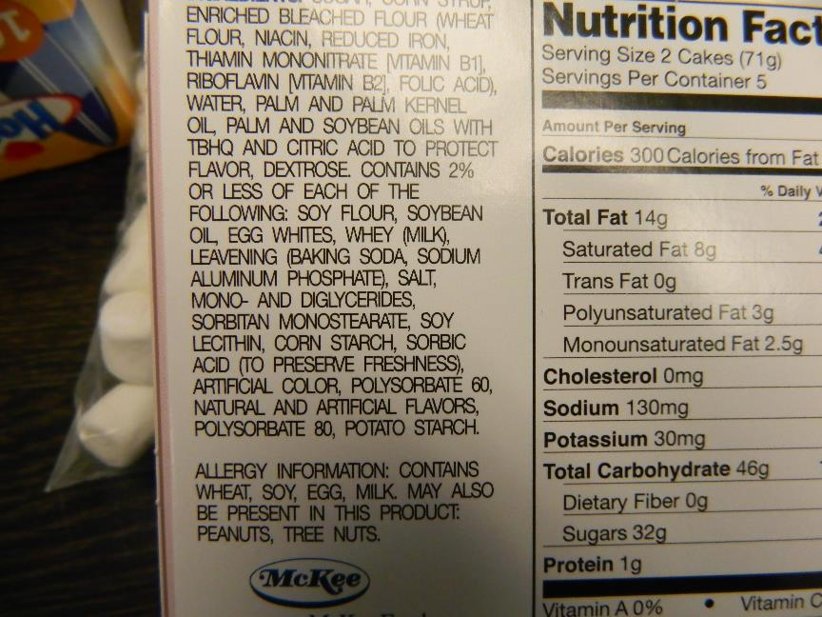
Phosphates are also found in Processed Foods

Slide 7
For Further Explanations and Information
Gary S. Williams, Director of Plants, (434) 946-5769 Mondays thru Friday
or by email at gary.williams@amherstva.gov
Becky L. Cash, Lead Water Operator, (434) 946-1267 Wednesday thru Saturday
or by email at becky.cash@amherstva.gov

